Slide 1

Is it possible to predict the popularity of a Tv show by its characteristics?
Data mining and machine learning final project
Ariel Ben Moha 206615072
Shira Siton 318972551

Slide 2







Research
Data
Acquisition
Data
Cleaning
EDA
Machine
learning
Conclusions

Slide 3

Our research - intro
Research question:
Can we predict the popularity of TV show by some characteristics as genre, year of published, chapter Length, user reviews, critic reviews and views?

Slide 4
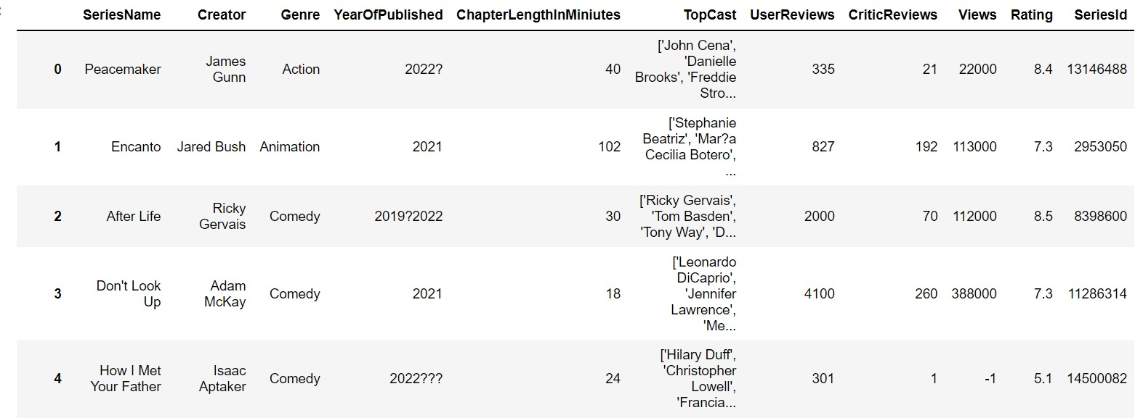
Step one Date Acquisition

Slide 5
Crawling
We took the data from https://www.imdb.com/ website. We used Beautiful Soup for the crawling.
During the crawl step we encountered three main difficulties:
Every series has a random ID which made it difficult for us to do the crawling.
2. Many websites we reached out to in order to receive information regarding series characteristics, blocked our access to this information, a thing which made it difficult for us to progress with our project
3. Scroll down the page

Slide 6
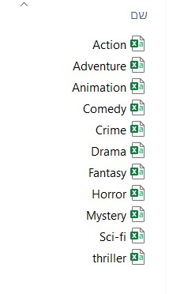
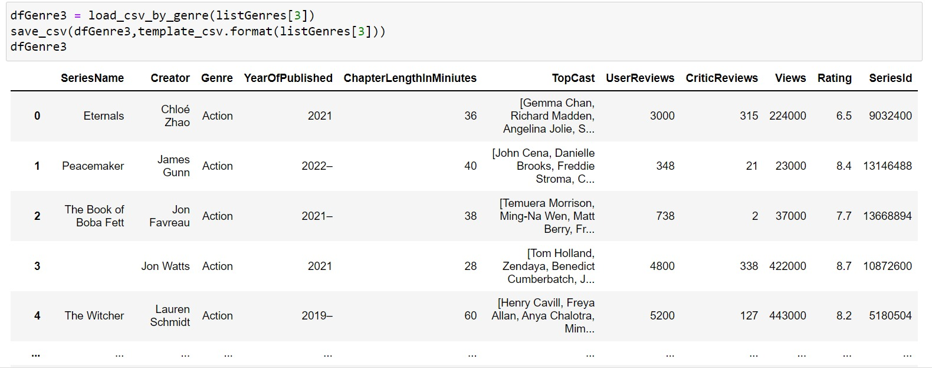
Genres DataFrame to csv file
We analyzed each genre individually
List of genres
DataFrame by ‘Action’ genre

Slide 7

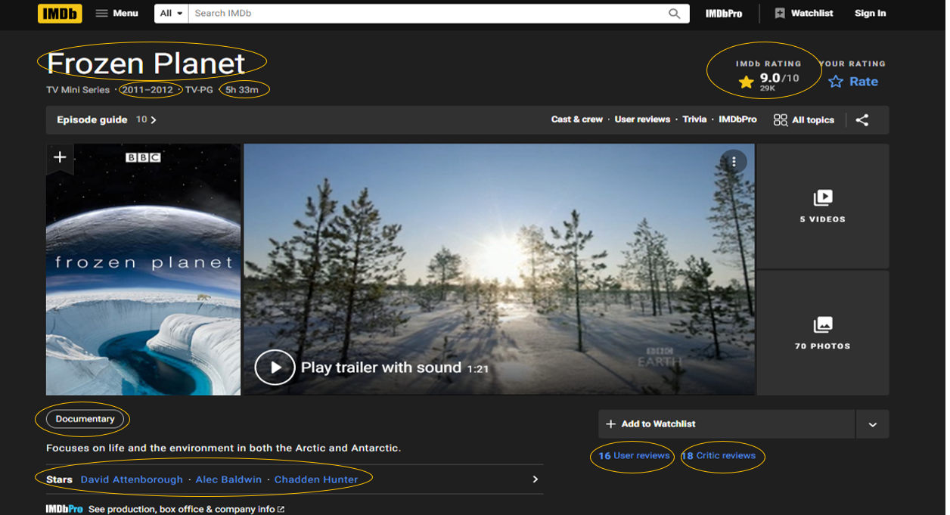

Slide 8
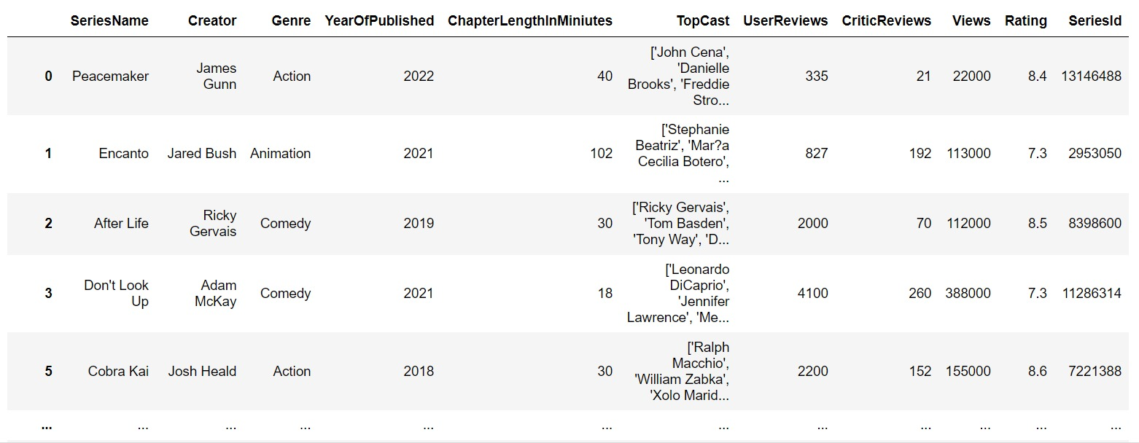
Data frame

Slide 9

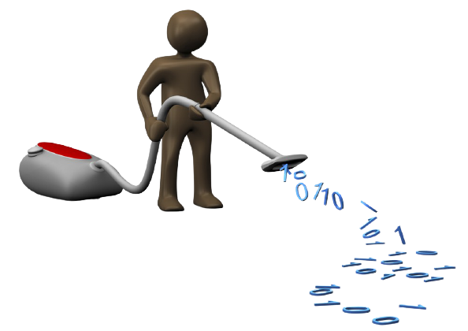
Step two Data cleaning
After we have merged all the genres DataFrames into one DataFrame, we analyzed this DataFrame
we removed and fixed rows with missing values and duplicates rows

Slide 10
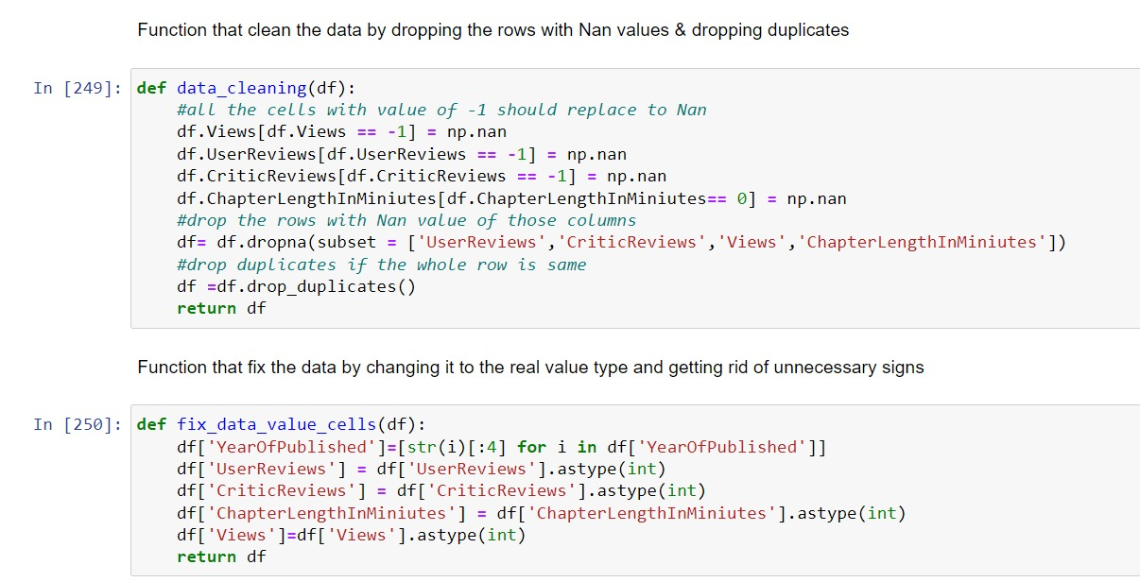
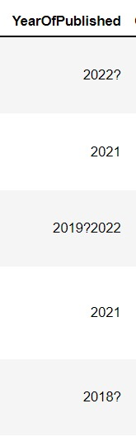
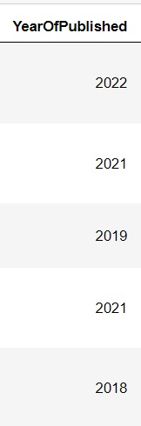
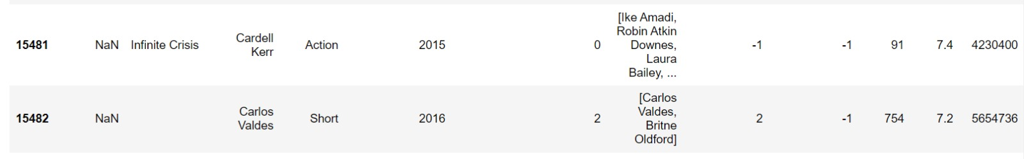
Part of the code
we removed and fixed rows with missing values and duplicates rows
We removed irrelevant marks from DataFrame
We dropped rows with many missing values

Slide 11

Step three
EDA
In the data analysis phase, we chose visualizations that will help us know if is it possible to predict the connection between the popularity of a TV show(‘rating’) and its characteristics.

Slide 12
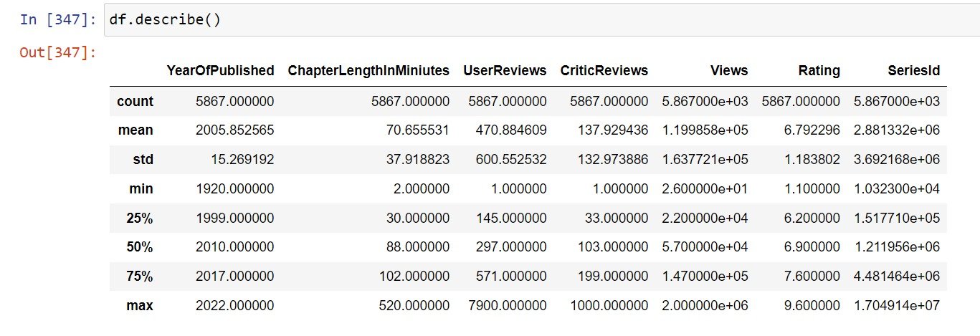

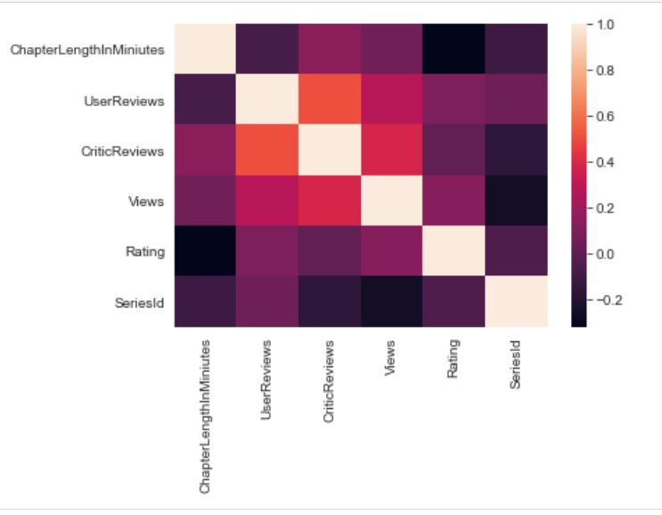
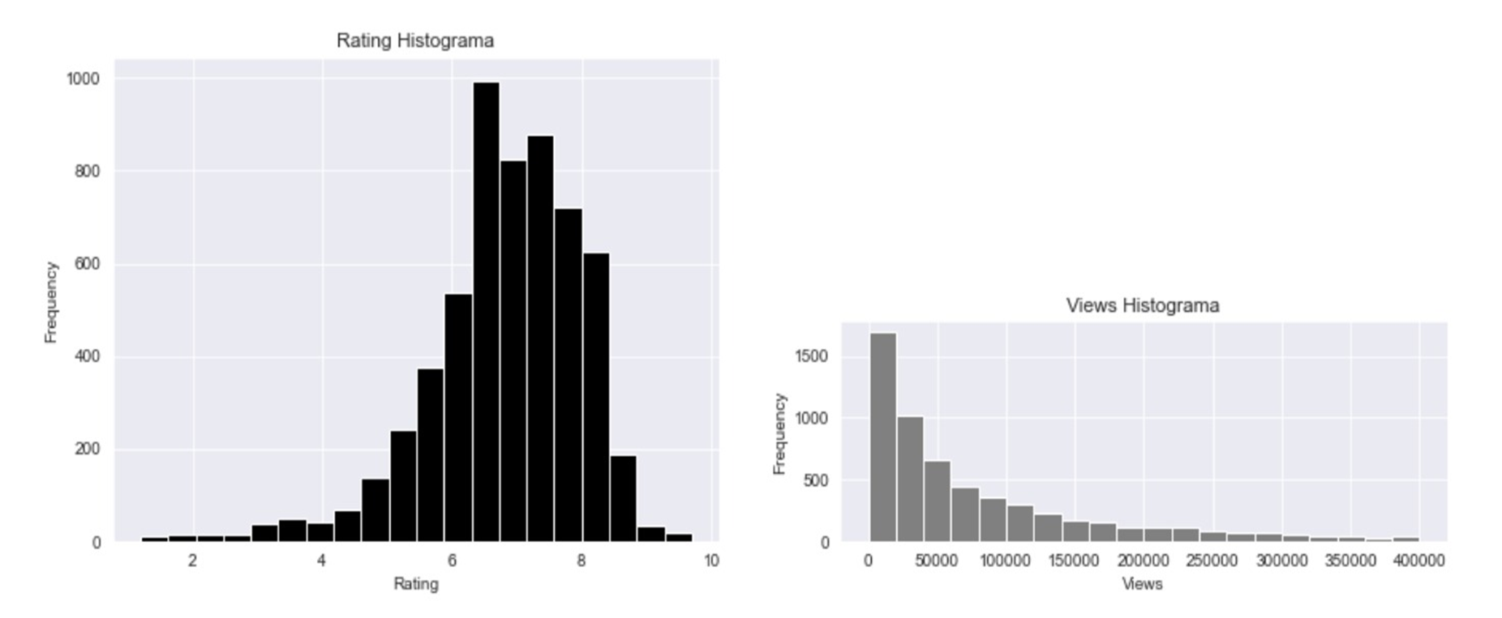
Statistical properties of the dataset
Heatmap
The correlation between the features
Series rating distribution
Series view distribution

Slide 13
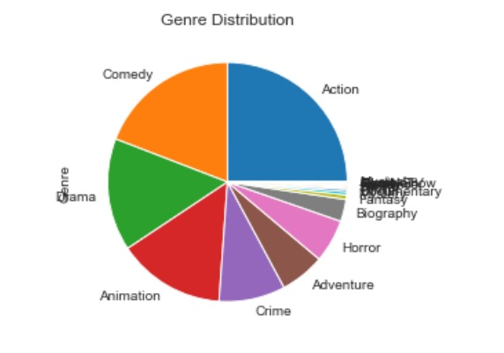
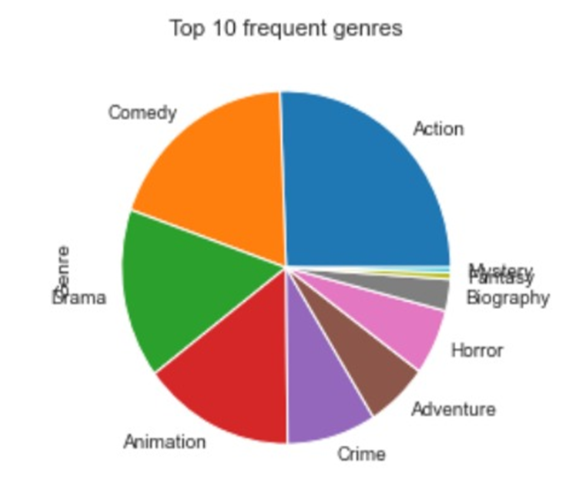

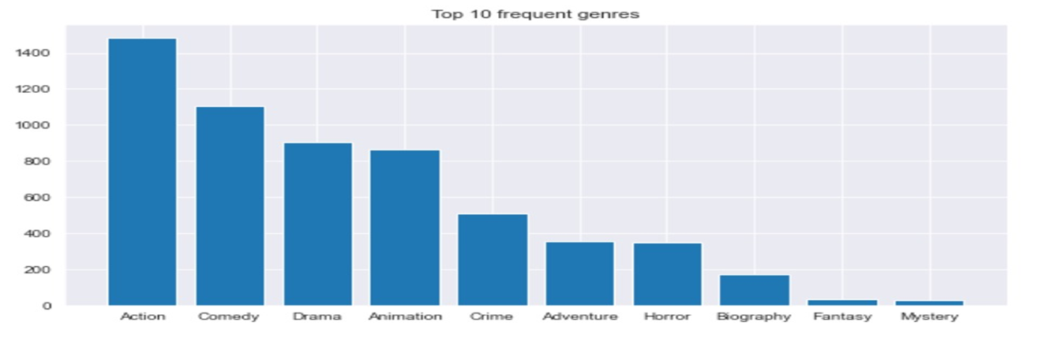

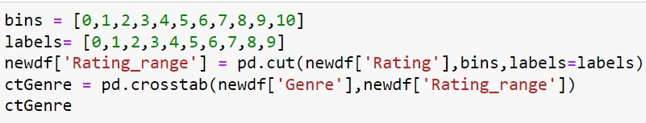
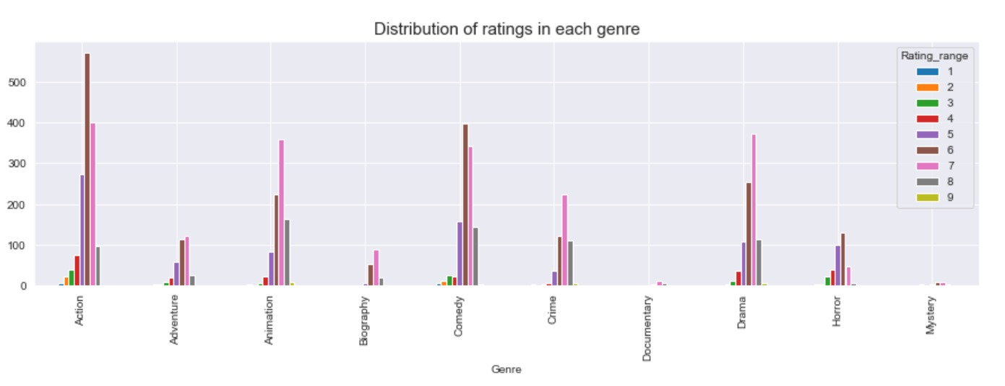
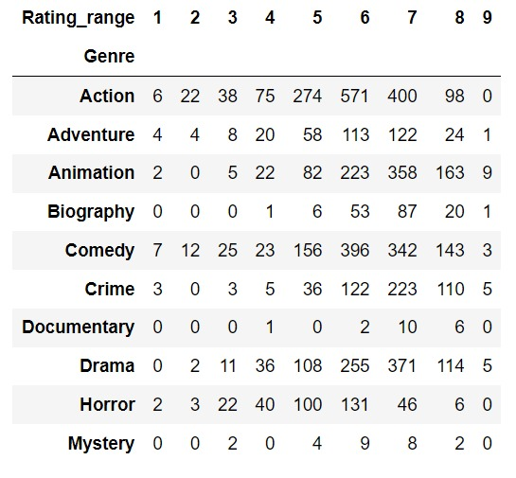
Research- genre feature
We took the 10 most common genres and used them for those pie & bar charts
we create a Rating range to show the values in cross tabulation

Slide 14
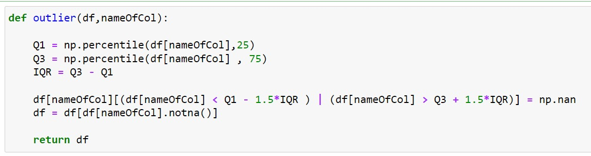
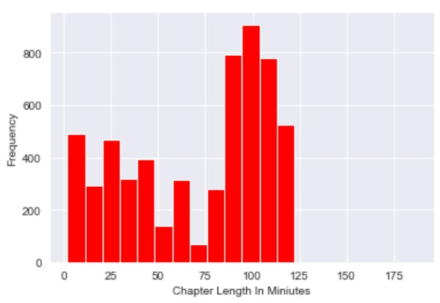
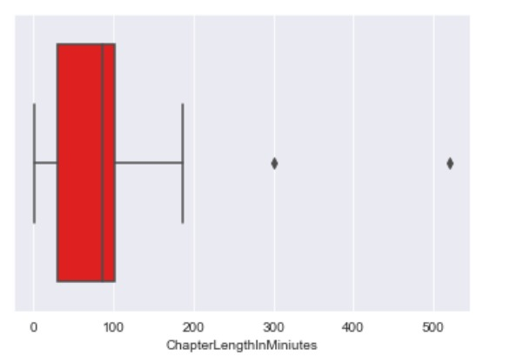
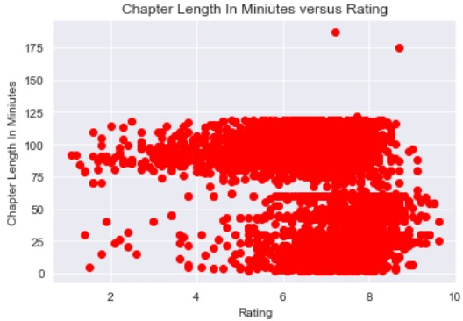
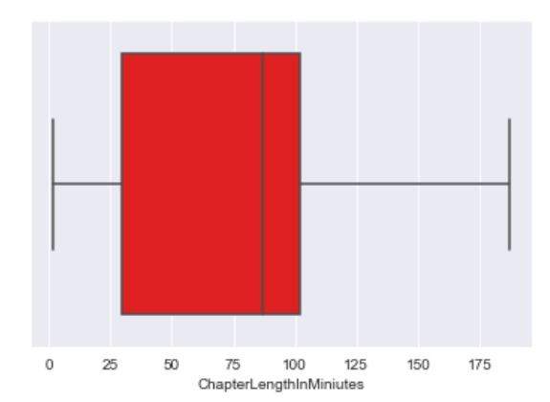
Using boxplot to find the outlier values
Research- chapter length feature

Slide 15
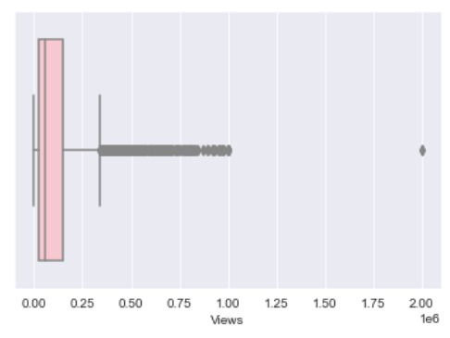
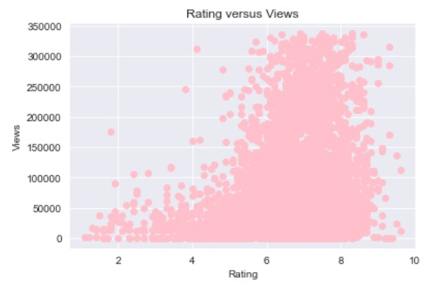
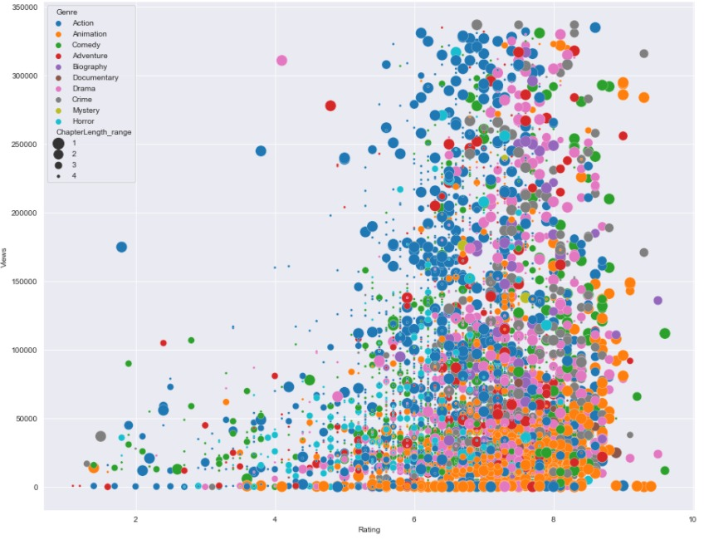
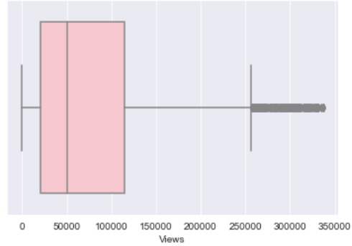
Research- chapter length feature
A combination of the four features into a single graph

Slide 16
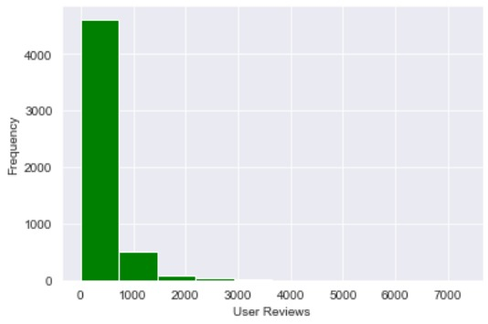
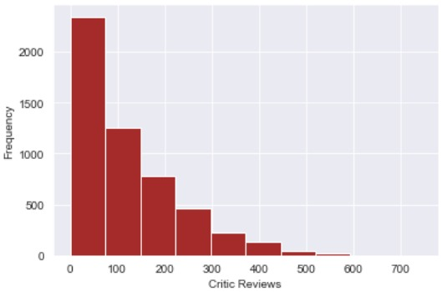
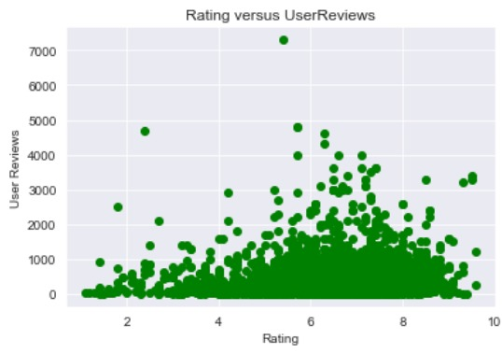
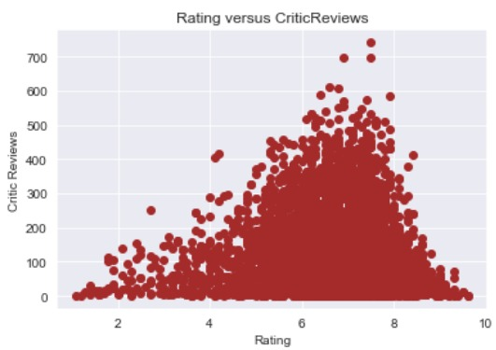

Research- user reviews feature
Research- critic review feature
Can you see the similarity?
For more data about Normal Distribution
Click Here
There are more visualizations in our code that we have chosen not to display in the presentation

Slide 17

Step four Machine Learning
In the machine learning section, we anticipate the future rating of an Tv series.
we performed actions to increase the chances of success.

Slide 18
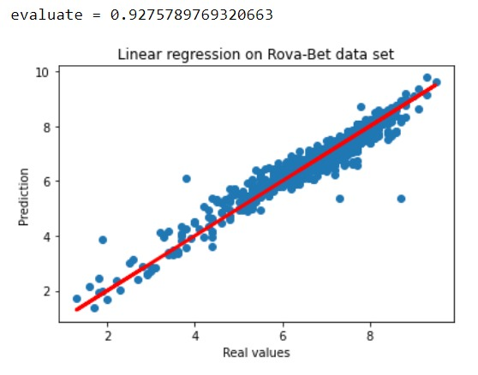

We used Scatter Plot to presents the model forecast against reality

Slide 19
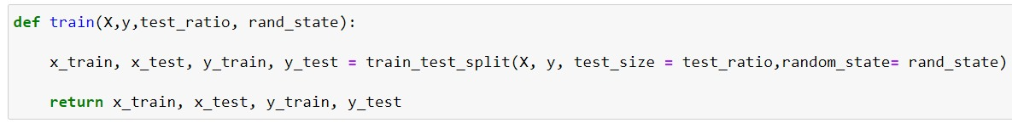
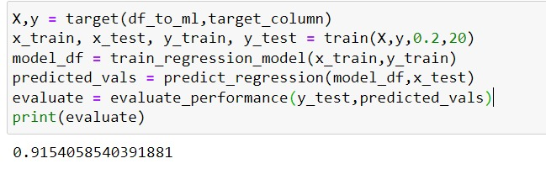
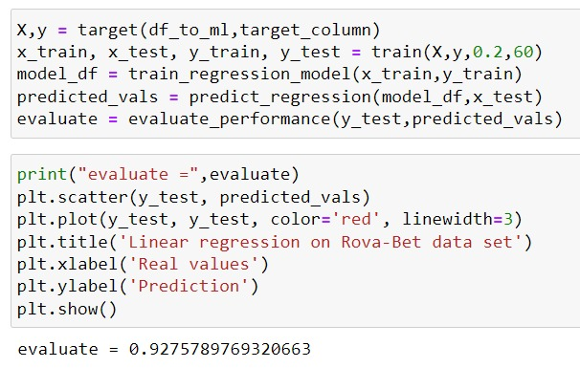

Improving the model

Slide 20
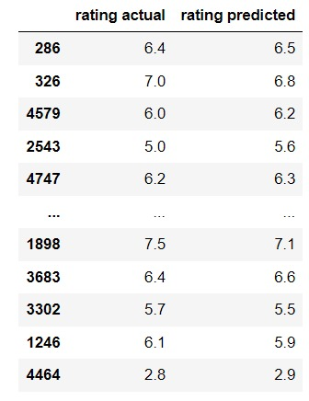
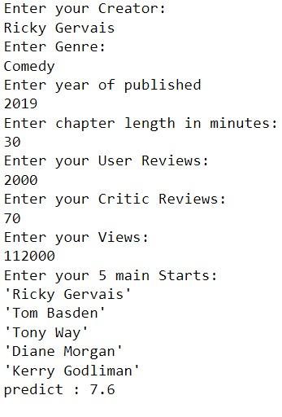
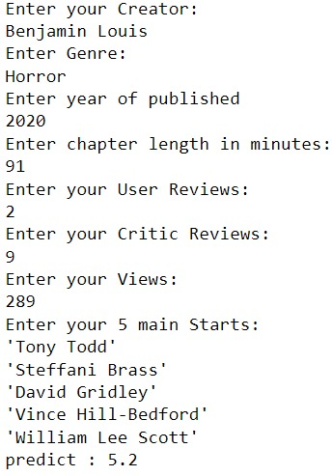
Here we can find out about the rating of a particular tv series by its characteristics
And this is a tool that can help us know if a TV series is about to succeed or not

Slide 21

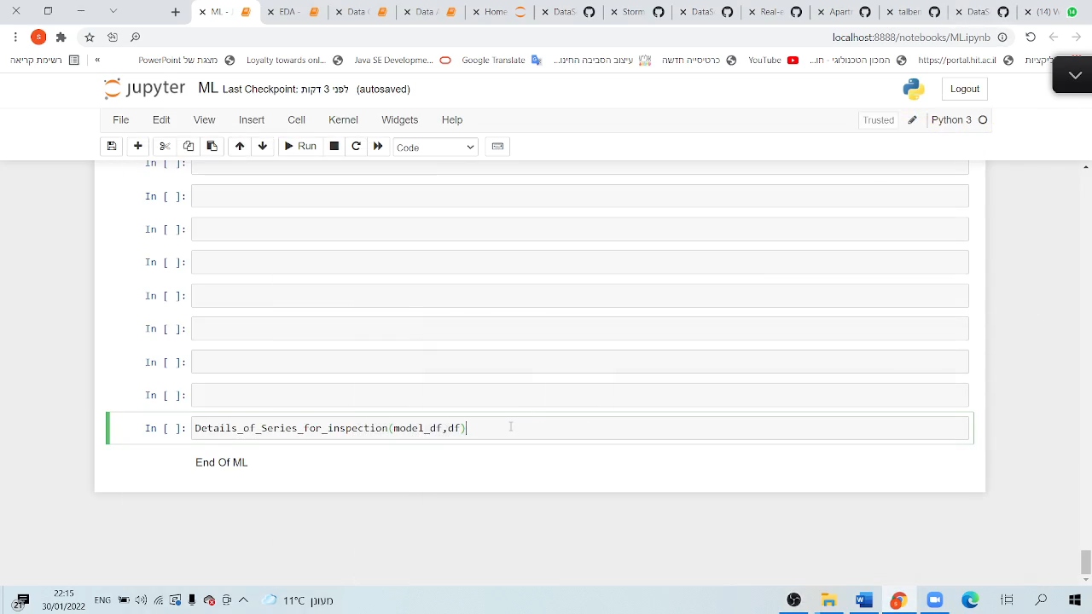
WOW EFFECT

Slide 22

Conclusions
We succeed to predict if a TV series will get a high Rating by its characteristics
We succeed to find out which characteristics can promote a Tv series Rating

Slide 23


Ariel Ben Moha
206615072
Shira Siton
318972551

